Slide 1
Front End Web Development
The nice and shiny part.

Slide 2
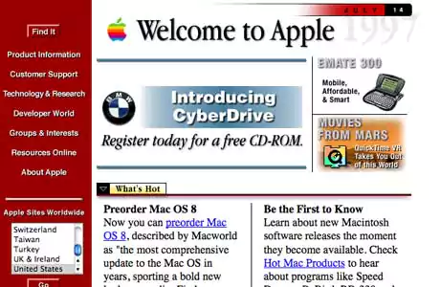
The Beginning
HTML and CSS
Raw Javascript
Very simple manipulations
Apple’s website in 1996

Slide 3
Moving forward to 2006
More complex media
Internet connections were much faster
JQuery
Still widely the best choice to build many traditional websites
AJAX (2005)
Ability to load more data in a page without refreshing/visiting another page

Slide 4
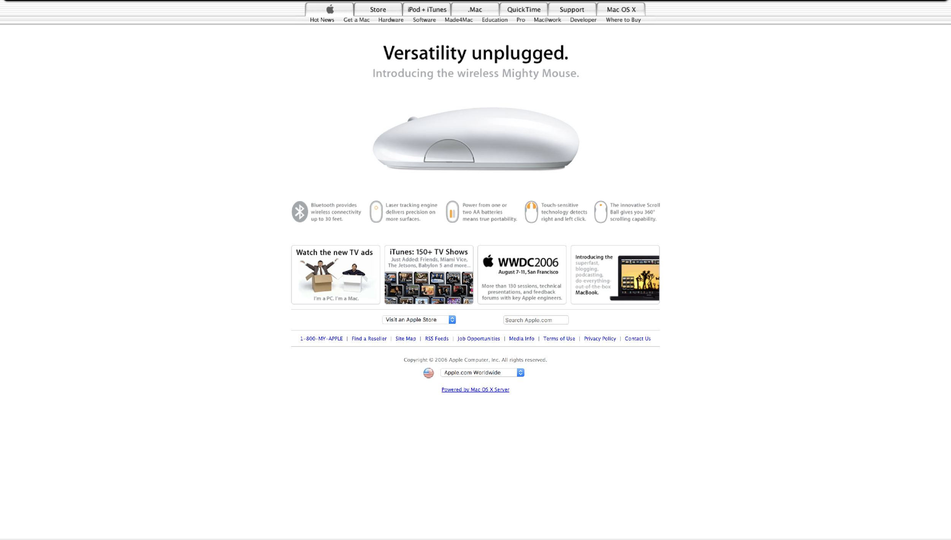
Apple 2006

Slide 5


2011-2013
HTML5 Finalized
DOM is now a central point of the HTML specification
Now the center of how a webpage exists.
To make advanced changes to a webpage have to use the DOM
Support for graphics drawing and advanced 3D rendering
Much better alternative to Flash
Web Applications on the Rise
Dynamic content manipulation
Many complex layers like a native application
Typically much more complex manipulation of the DOM
Gmail, Trello, Facebook, Twitter

Slide 6


2013-Now
Incredibly rich and complex applications that are platform agnostic
Modern frameworks dedicated to simplifying the creation of good WebApps
React, Flux, Redux, Angular, Express, etc…
JavaScript “compiler” webpack
Large scale ecosystem maturation (npm and yarn)
Evolution of JS with modern features:
ES5, ES6/ES2015, ES7/ES2016, TypeScript, CoffeeScript, JSX, etc

Slide 7
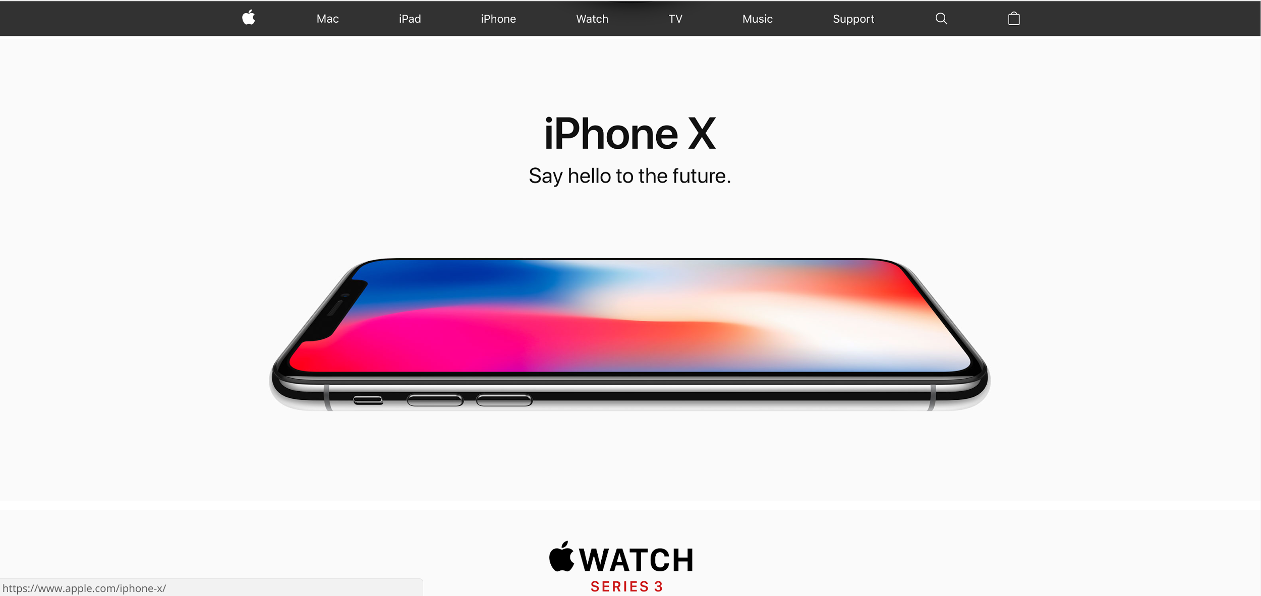
Apple (Today)

Slide 8
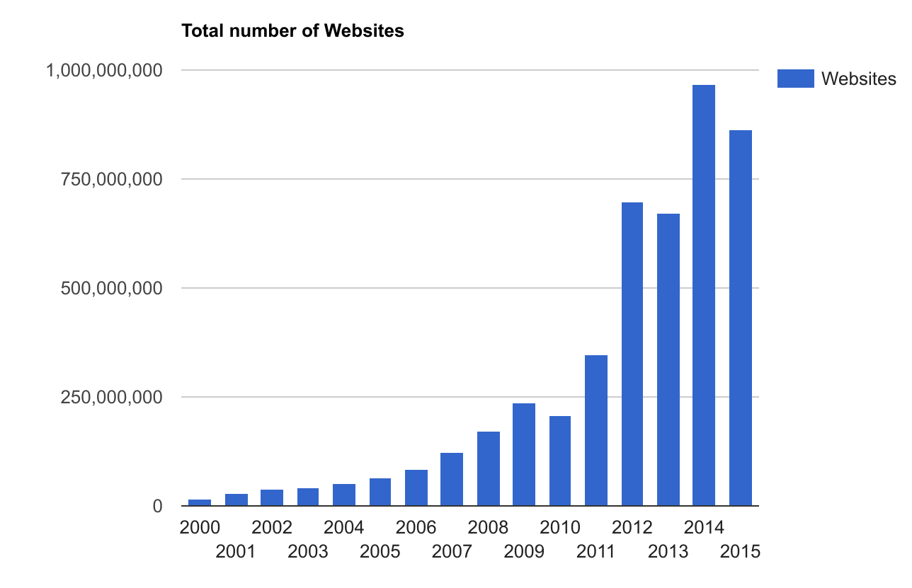

Slide 9
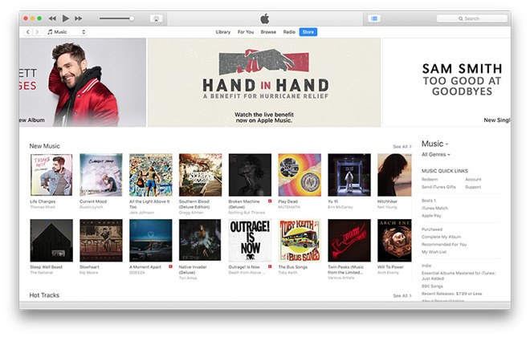

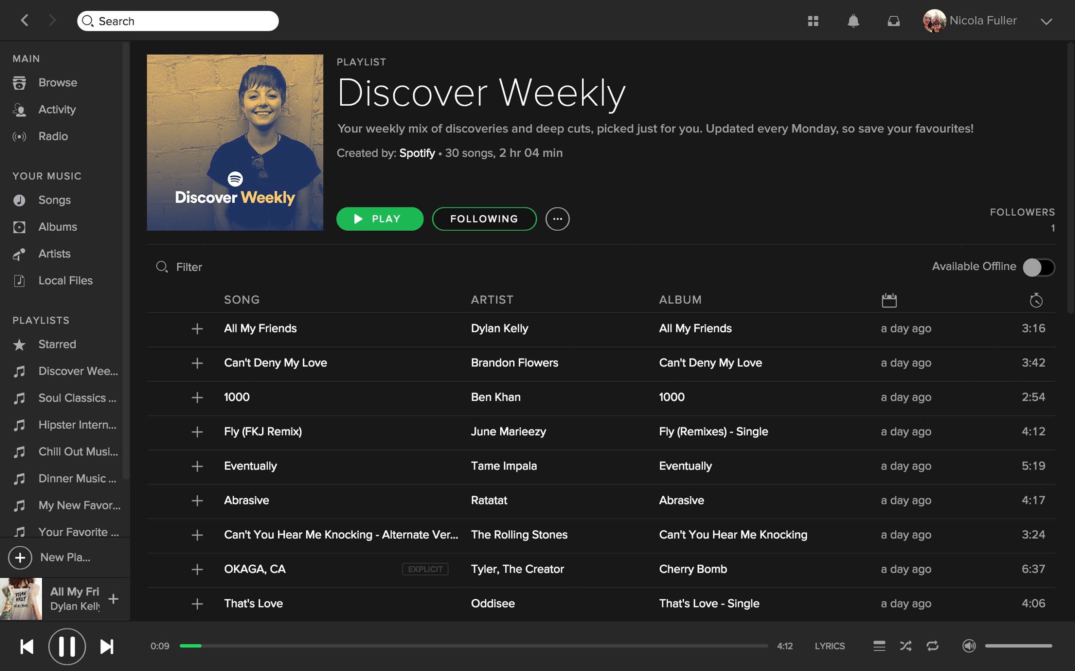
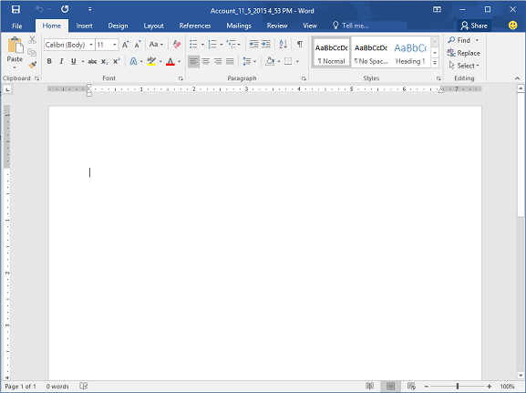
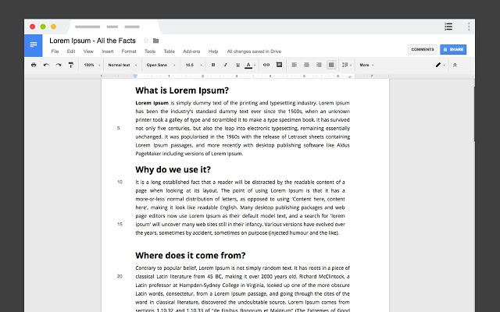

The web is #1 platform for new products
The number of websites being created every year far exceeds the number of mobile and desktop apps being created

Slide 10
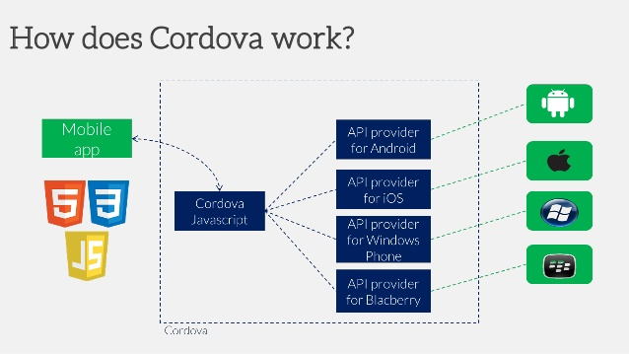

“Let’s run JavaScript everywhere”
Develop for the web first
Port web app to all other platforms
Possible to create native apps from web app/frameworks

Slide 11
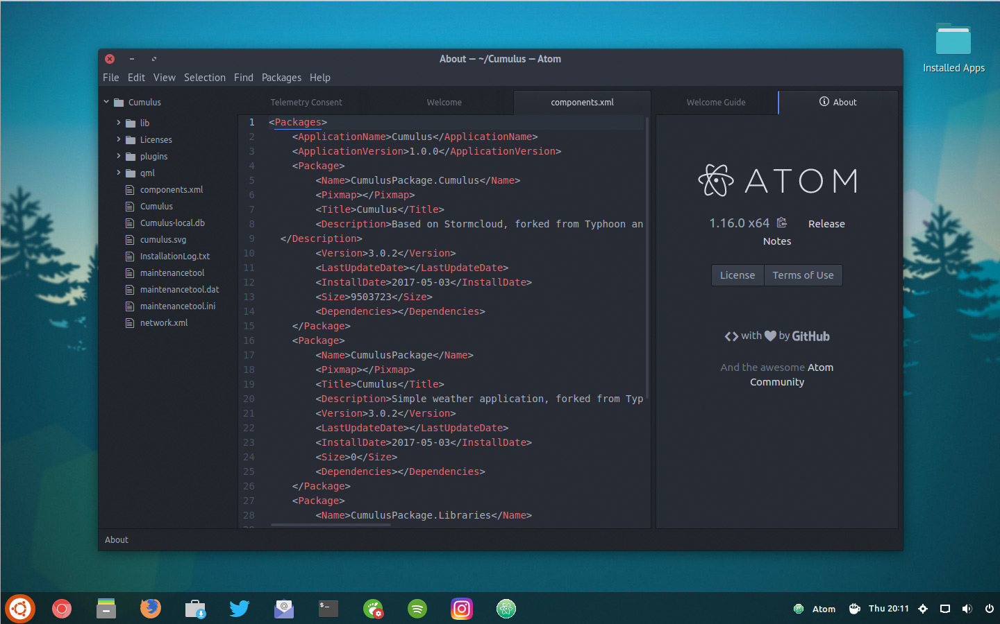

Slide 12
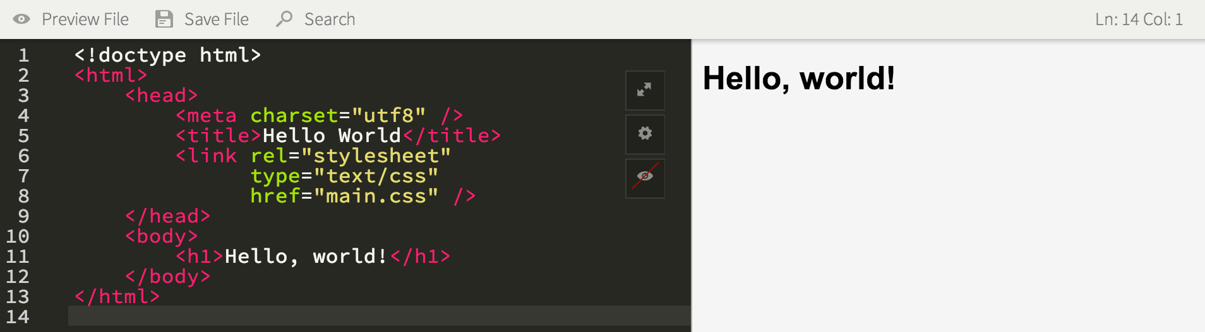
HTML
HyperText Markup Language used to render pages on browsers

Slide 13

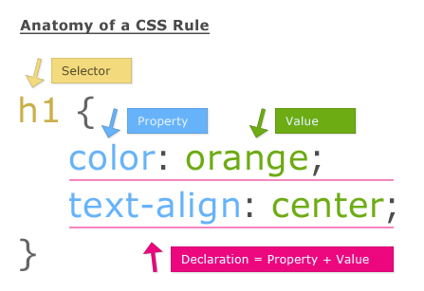
CSS
Style sheet language: easier way of styling web pages
Very flexible and convenient

Slide 14
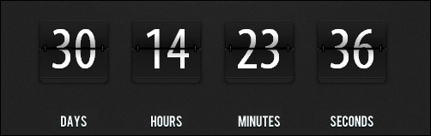
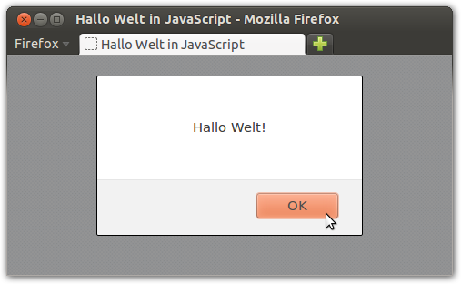
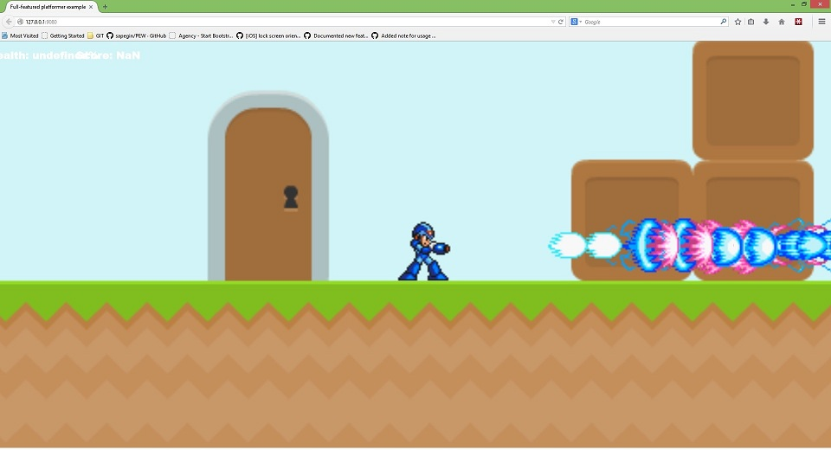
JavaScript
Client side programming language used to make web pages interactive or dynamic

Slide 15

The Document Object Model
The underlying structure (anatomy) of a web page.
Underlying data structure is a tree
Very painful to manipulate with raw JavaScript
Many if not all modern front-end libraries or frameworks manipulate this to make their changes to the page

Slide 16

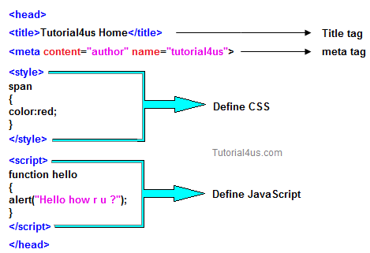
The Head
All the things you don’t see
Metadata
Sytlesheets
Javascript
Your browser processes the head before rendering the page
Important: any JS in the head doesn’t know about anything in your body

Slide 17
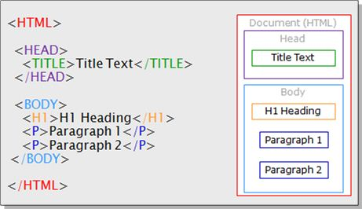
Body
The actual content of the page
All elements rendered on the page must be in the body!
You can also put style and script info in your body
It is common/good practice to place any JS that interacts with the DOM right before you close the body.

Slide 18
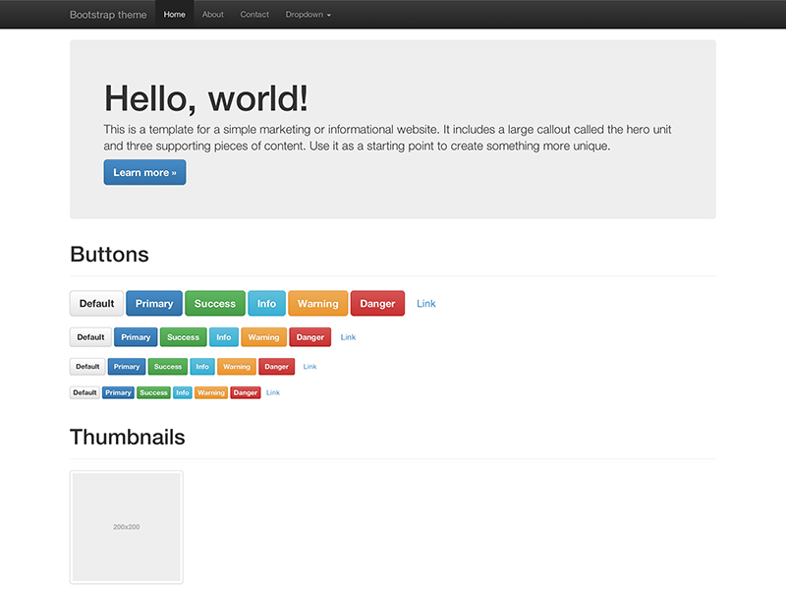
Modern Front End Frameworks
Makes it possible to create more consistent web pages much faster (less code)
Bootstrap
Foundation
Angular
React

